Slide 1
A Denial of rights gone viral
By Siarra Morrow

Slide 2
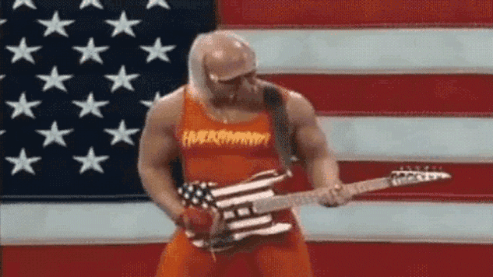
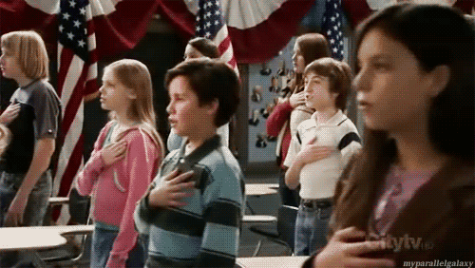
National Pride
The American Flag
The National Anthem
The Pledge of Allegiance

Slide 3
Motivating the nation
City College of New York held a ceremony with kids of multiple nationalities wrapping themselves in the flag (Ellis 4)
Caught the attention of an important GAR member (Ellis 4)
This collaboration was then responsible for organizing the celebration of ”The Four Hundredth Anniversary of the Discovery of America by Columbus) (Ellis 8). The Pledge was made to be part of this event but later became a daily part of our lives.

Slide 4
Dissection of the Pledge
Definition of the Pledge of Allegiance – ”A solemn oath of allegiance or fidelity to the U.S.” (dictionary.com Pledge of Allegiance)
Argument: Pledge if not an oath of loyalty to the government but to the nation what we have created and are in control of.
We are not in control of our government as seen in the why that presidential elections work.
The electoral college has the final and most important vote of all. Our vote is an illusion of power.
“The constitution does not specifically require electors to cast their votes according to the popular vote in their states…” (latimes.com).

Slide 5
”Liberty and Justice for All”… Really?
Argument: Court System is fair in its organization to ensure the most just outcome in legal cases
Supreme court has a variety of nationalities to avoid racial bias in decisions.
There have only been 3 non white supreme court justices since its establishment in 1789 (wikipedia.org)
Lack of fairness in court system can be seen in the allowance and enforcement of the Jim crow laws which did not end until 1954.
The Jim Crow laws and other segregation laws enforced by the Plessy v. Ferguson court case, which ruled that establishments should be “separate but equal”.
Definitely separate but NOT EQUAL

Slide 6
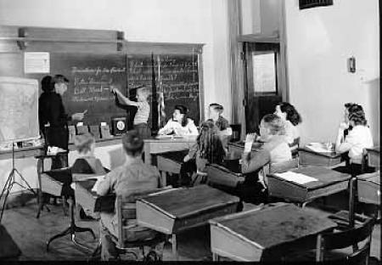
Separate not Equal
(The Civil Rights Movement)
(Saban hall)

Slide 7
”Under God”… Which God?
Argument: inclusive of all Americans
70.6% of Americans are some form of Christian, 5.9% are non-Christian, 15.8% are other religions, and 1.5% are either unaffiliated with a religion, atheist, or agnostic (pewforum.org).
Argument: harmless and is representative of our country’s religious past
The Puritan church supported slavery
Why would we honor a past we are trying to advance from?

Slide 8
A Violation of the First Amendment
Black Muslim students In New Jersey almost suspended for practicing their religion and not reciting the Pledge (Ellis156).
Girl almost suspended for not reciting pledge because she felt that America is not the land of the free (Ellis 157).
My teacher harassed me and tried to get me suspended until my principle alerted her of my rights and instructed her not to continue.

Slide 9
A Decision needs to be Made
Which should we value more:
OUR RIGHTS or A LIMITED WAY OF THINKING

Slide 10
Works Cited
Ellis, Richard (Richard J.). To the Flag : the Unlikely History of the Pledge of Allegiance. Lawrence, Lawrence : University Press of Kansas, 2005.
“Sabin Hall.” Sabin Hall | Rod Library, University of NorthernIowa, www.library.uni.edu/collections/specialcollections/university-archives/building-histories/sabin-hall.
“The Civil Rights Movement: The Surge Forward: 1954-1960.” Civil Rights: The Surge Forward: 1954-1960,www.historyonthenet.com/authentichistory/1946-1960/8-civilrights/1954-1960/index.html.
Wormald, Benjamin. “Religious Landscape Study.” Pew Research Center's Religion & Public Life Project, 11 May 2015, www.pewforum.org/religious-landscape-study/.

