Slide 1
Literacy Narrative and Sponsor of Literacy
Exploration of Theory and Genre
Engl 110

Slide 2
Questions to consider throughout this presentation…
Prior to the 20th century, what population/which persons, were largely literate? Why?
How do people become literate?
How did you acquire literacy?
What is the significance of acquiring literacy? What does literacy give people?
What is a literacy narrative?
How do students/writers compose literacy narratives?

Slide 3
Literacy
Literacy is defined as “the ability to read and write” (www.merriam-webster.com/dictionary/literacy)
Having knowledge or competence. Particularly in a specific area
Financial literacy

Slide 4
Question #1
Prior to the 20th century, what population/which persons, were largely literate? Why?
Upper/middle class white men
Access and privilege
Wealth/capital
The clergy
Before the creation of the printing press, the clergy had the bibles and hand copied each copy. So they controlled how many were in existence and who received them.

Slide 5
Literacy (Cont’d)
According to theorist Deborah Brandt, “Literacy looms as one of the great engines of profit and competitive advantage in the 20th century: a lubricant for consumer desire; a means for integrating corporate markets; a foundation for the deployment of weapons and other technology; a raw material in the mass production of information” (Brandt 166).
Essentially, as the access to literacy has increased, it has created…

Slide 6
Literacy (Cont’d)
Brandt continues, “As ordinary citizens have been compelled into these economies, their reading and writing skills have grown sharply more central to the everyday trade of information and goods as well as to the pursuit of education, employment, civil rights, status. At the same time, people’s literate skills have grown vulnerable to unprecedented turbulence in their economic value, as conditions, forms, and standards of literacy achievement seem to shift with almost every new generation of learners” (Brandt 166).

Slide 7
Question #2
How do people become literate individuals?

Slide 8
Brandt’s Theory of Literacy Sponsorship/Sponsors of Literacy
“…literacy as an individual development… Sponsors, as I have come to think of them, are any agents, local or distant, concrete or abstract, who enable, support, teach, model, as well as recruit, regulate, suppress, or withhold literacy—and gain advantage by it in some way. Although the interests of the sponsor and the sponsored do not have to converge (and, in fact, may conflict) sponsors nevertheless set the terms for access to literacy (166).

Slide 9
Brandt’s Theory (Cont’d)
“Brandt/Sponsors of Literacy wield powerful incentives for compliance and loyalty. Sponsors are a tangible reminder that literacy learning throughout history has always required permission, sanction, assistance, coercion, or, at minimum, contact with existing trade routes. Sponsors are delivery systems for the economies of literacy, the means by which these forces present themselves to— and through—individual learners. They also represent the causes into which people’s literacy usually gets recruited” (166-167)

Slide 10
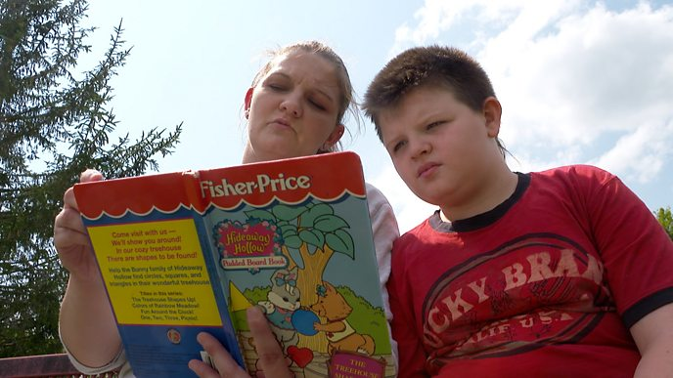
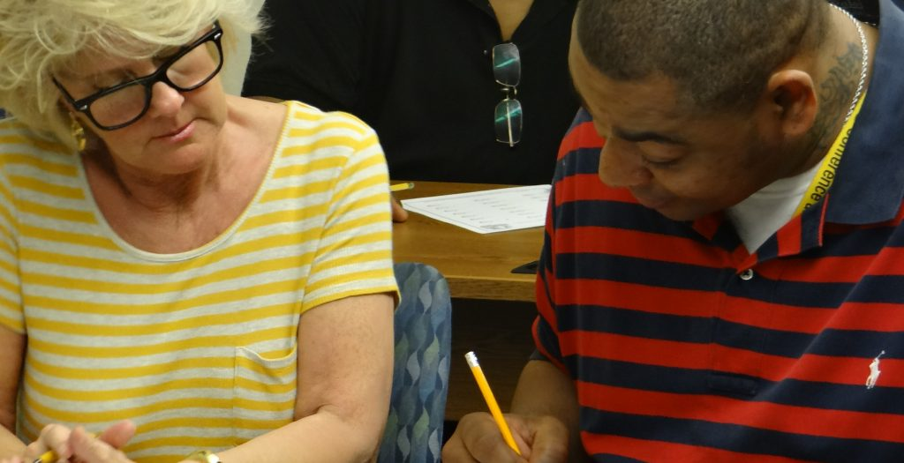
Questions #4 & #5
Something to consider: How did you become literate?
What is the significance of acquiring literacy? What does literacy give people?

Slide 11
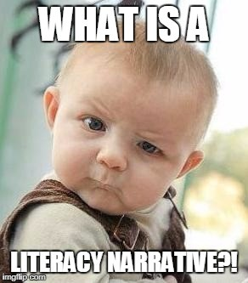
Question #6- What is a literacy narrative?
a type of autobiographical essay that focuses on personal experiences with literacy (speaking, writing, reading, and the like) in order to confirm the importance of these rhetorical experiences in a person's life.
a story of how you became literate and how it has affected your life.

Slide 12
Question #6- What is a literacy narrative?
a collection of items that describe how you learned to read, write, and compose. Could include a story about learning to read cereal boxes and a story about learning to write plays. Some people will want to record their memories about the bedtime stories their parents read to them, the comics they looked at in the newspaper, or their first library card. Others will want to tell a story about writing a memorable letter, leaning how to write on a computer or taking a photograph; reading the Bible, publishing a ‘zine’, or sending an e-mail message.
Your literacy narrative can have many smaller parts, but they will all be identified with your name. For instance, you might want to provide a story about learning to read a as a child, a digitized image of one of your old report cards, a story about writing a letter as a teenager, a photograph of you as a young child; a song you learned when you were in school).

Slide 13
Question #7- How do students compose lit narratives?
First, we examine lit narrative samples
Second, we examine the parts of the genre
Third, we compose an outline
Fourth, we consider our own journey with
Literacy and begin to craft a draft.
**It’s a personal narrative. No two people are
Going to have the same experience with literacy
acquisition
https://dtext.org/f14/108/nfgw-litnarr.pdf
https://engl110bcrowe.commons.gc.cuny.edu/nortons-writing-a-literacy-narrative/

Slide 14
The Parts of the Literacy Narrative
The outline- should, at the very least, contain a thesis statement and three (3) complete topic sentences (one for each body paragraph). Some people like to write more detailed outlines, some people like to write less-detailed, keyword outlines.
More is BETTER!
A literacy narrative uses the elements of story (plot, character, setting, conflict) to recount a writer's personal experience with language in all its forms–reading and writing, acquiring a second language, being an insider or outsider based on literacy level, and so on.
A well-told story.
Vivid detail.
Some indication of the narrative's significance.
Describe the setting.
Think about the key people.
Write about “what happened”
Consider the significance of the narrative.
Draft a beginning.

