Slide 1
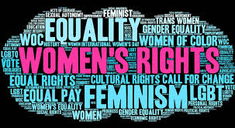
THE ROAD TO EQUALITY
BEN BERKOWITZ
ENGLISH 110

Slide 2
FAMOUS WOMEN'S PROTESTS SINCE 1900
Women’s suffrage parade
WOMENS MARCH OF 2017
WOMEN'S STRIKE FOR EQUALITY
MARCH 3, 1913
LED BY ALICE PAUL AND INEZ MILHOLLAND
STRATEGICALLY PLANNED THE PRESIDENT WILSON'S INAUGIRATION
LED TO 19TH AMENDMANT
AUGUST 26, 1970
SPEARHEADED BY BETTY FRIEDAN
CELEBRATED THE 50TH ANNIVERSARY OF THE 19TH AMENDMANT
50,000 WOMEN PARADED DOWN NEW YORK CITY'S FIFTH AVENUE
LED TO TITLE IX IN 1972
JANUARY 21, 2017
LARGEST SINGLE-DAY PROTEST IN U.S HISTORY
GOAL WAS TO UNIFY WOMEN AND MINORITY GROUPS AROUND ISSUES SUCH AS REPRODUCTIVE RIGHTS, IMMIGRATION, AND CIVIL RIGHTS
LED TO THE ESTABLISHMENT OF THE #METOO MOVEMENT

Slide 3
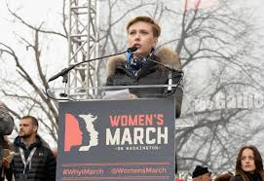
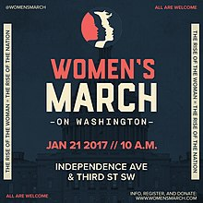
Woman's march of 2017
3.5-5 MILLION PARTICIPANTS ATTENDED ACROSS THE GLOBE
IN WASHINGTON D.C. ALONE, 470,000 PEOPLE ATTENDED
MANY FAMOUS ACTIVISTS AND ACTRESSES ATTENDED AND SPOKE BY THE MARCH, INCLUDING ASHLEY JUDD, SCARLETT JOHANSSON AND MELANIE CAMPBELL
TWO MAIN AGENDAS OF THE MARCH:
1. OUTRAGE TOWARD THE INAUGIRATION OF DONALD TRUMP
2. CHALLENGING THE PRIVELEGE AND POWER MEN TEND TO HAVE OVER WOMEN

Slide 4
SO DID THE MARCH SUCCEED?
MANY BELIEVE THAT THE MARCH WAS "A WASTE OF TIME AND RESOURCES" AND DID NOT BRING ABOUT ANY TANGIBLE RESULTS
LACK OF INCLUSIVENESS OF DIFFERENT WOMEN OF DIFFERENT RACE AND GROUPS
HOWEVER, IT CERTAINLY DREW ATTENTION TO THE DISCONTENT WOMEN FELT AND ALLOWED MANY TO EXPRESS THEIR VOICES BELIEVING THEY WOULD FINALLY BE HEARD
#METOO
CHANGES IN THE WORKPLACE
MILLIONS OF NEW JOBS CREATED FOR WOMEN

Slide 5
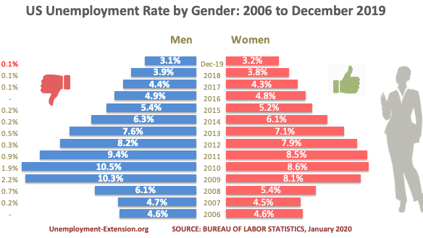
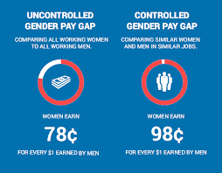
UNEMPLOYMENT AND THE WAGE GAP
AS OF DECEMBER 2019 UNEMPLOYMENT HIT A HISTORIC LOW (3.2%!)
DUE TO COVID-19 THOSE NUMBERS HAVE GONE UP FOR BOTH GENDERS
According to a Department of Labor study, differences in education, experience, choice of industry and occupation, career interruptions, and hours worked explain all but 5 cents of the so-called wage gap
Immeasurable components of compensation—such as flexible work schedules and the time given to children —likely account for a lot of the remaining gap.

Slide 6
In conclusion
Womens rights are nowhere near perfect yet ( Studies show that it will take the world until year 2133 to close the economic gap entirely)
The world has made massive strides in the right direction since the march
Changes in women's pay, job ability and respect
Women can feel safer and express themselves regarding sexual assault with this renewed feeling of unity

Slide 7
WORKS CITED:
“As Job Creation Exceeds Expectations Again, Women Workers See Further Gains.” The White House, 2020, www.whitehouse.gov/articles/job-creation-exceeds-expectations-women-workers-see-gains-2/.
Boccia, Romina. “Trump’s Reversal of Obama Pay Gap Rule Is Good News for Women.” The Heritage Foundation, 2017, www.heritage.org/economic-and-property-rights/commentary/trumps-reversal-obama-pay-gap-rule-good-news-women.
Duffin, Erin. “ Monthly Unemployment Rate of Women in the United States from October 2019 to October 2020.” Statista, 2020, www.statista.com/statistics/193298/unadjusted-unemployment-rate-of-women-in-the-us/#:~:text=Unemployment%20rate%20of%20women%20%2D%20unadjusted%20monthly%20number%20in%20the%20U.S.%20October%202020&text=In%20October%202020%2C%20the%20unadjusted,States%20stood%20at%206.5%20percent.
Roberts, Rebecca Boggs. “The Great Suffrage Parade of 1913.” Women's Suffrage Centennial Commission, Women's Suffrage Centennial Commission, 1 Apr. 2020, www.womensvote100.org/the-suff-buffs-blog/2020/4/1/the-great-suffrage-parade-of-1913.
“THE STATE OF THE GENDER PAY GAP 2020.” Payscale, 2020, www.payscale.com/data/gender-pay-gap#:~:text=IN%202020%2C%20WOMEN%20EARN%2081,job%20type%20or%20worker%20seniority.
Verniers, Catherine, and Jorge Vala. “Justifying Gender Discrimination in the Workplace: The Mediating Role of Motherhood Myths.”, 2018, go-gale-com.ccny-proxy1.libr.ccny.cuny.edu/ps/retrieve.do?tabID=Journals
Vogelstein , Rachel, and Rebecca Turkington. “Five Women’s Marches throughout History That Triggered Political Change.” The Lily, 2019, www.thelily.com/five-womens-marches-throughout-history-that-triggered-political-change/.

