Slide 1
THE MARCH OF 1965
Selma To Montgomery
Lea Gjurgjaj

Slide 2
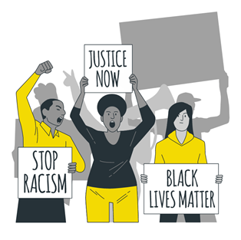
Selma to Montgomery March, served as the first steps in history that demanded a future free of segregation and racial discrimination.
A protest designed to display that all Americans, no matter their skin color, have the right to vote.
This March has been remembered and discussed throughout history for its peaceful approach
Led to the Voting Rights Act of 1965 which made it illegal for racial discrimination against voters.

Slide 3
Expository Essay
THESIS
Through the history of its origins, its leaders’ reputation and connections and the nonviolent approach the protesters took, the march exemplified that no matter the risk or the opposition racial discrimination in voting isn’t tolerated.

Slide 4
Argumentative Essay
THESIS
Through the history of its origins, its leaders’ reputation and the nonviolent approach the protesters took, the march of 1965 exemplified that no matter the risk or the resistance, peaceful protests are successful in delivering the necessary message and demanding change.

Slide 5
Argumentative Essay
Expository Essay
The history of the origins of the 1965 Selma to Montgomery March roots back to racial segregation, discrimination and countless attempts of African Americans to fight the unjust system created by white men.
The right to peaceful protest is much desired and inspirational to some citizens, however to others it is an indirect threat of morals, a call to change the ordinary. To others, peaceful protests are ineffective because in many cases they tend to turn violent.
Leaders that had a reputation for effective speeches, protests and methods to end racial discrimination, were the ones determined to take action and seek federal enforcement of voting rights.
The power of executing the first amendment right peacefully and constantly is what triggers the opposing side to turn violent. Such response proves that the peaceful protest is in fact effectively delivering the necessary message to the public, whether they decide to be part of the movement or not.
The Selma-to-Montgomery march, however, was not simply the product of inspiring leadership but also of the commitment of the civil rights community and its example to progressive change.

Slide 6
WORKS CITED
Astor, M. “Why Protest Movements Are ‘Civil’ Only in Retrospect.” The New York Times. Jun. 2020. Print.
Brown, Bryan. "Selma: how the Selma-to-Montgomery marches 50 years ago helped end discrimination against black voters." New York Times Upfront, vol. 147, no. 9, 23 Feb. 2015. Print.
Garrow, David J. Protest at Selma: Martin Luther King, Jr., and the Voting Rights Act of 1965. Yale University Press, 2015. Print.
Krotoszynski, Ronald J., Jr. "Celebrating Selma: the importance of context in public forum analysis." Yale Law Journal, vol. 104, no. 6, Apr. 1995, pp. 1411-1440. Print.
Mwamba, Jay. “Civil rights movement, led by Martin Luther King Jr., spread across U.S. to Africa, Europe.” Daily News. Feb. 2017. Print
Santoro, Wayne A. "The civil rights movement and the right to vote: black protest, segregationist violence and the audience." Social Forces, vol. 86, no. 4, 2008. Print.
Sherman, Amy. "FACT-CHECKING CLAIMS ABOUT SELMA AND VOTING RIGHTS ACT." Tampa Bay Times [St. Petersburg, FL], 6 Mar. 2015. Paper.

