Slide 1
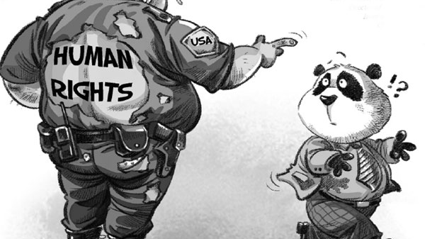
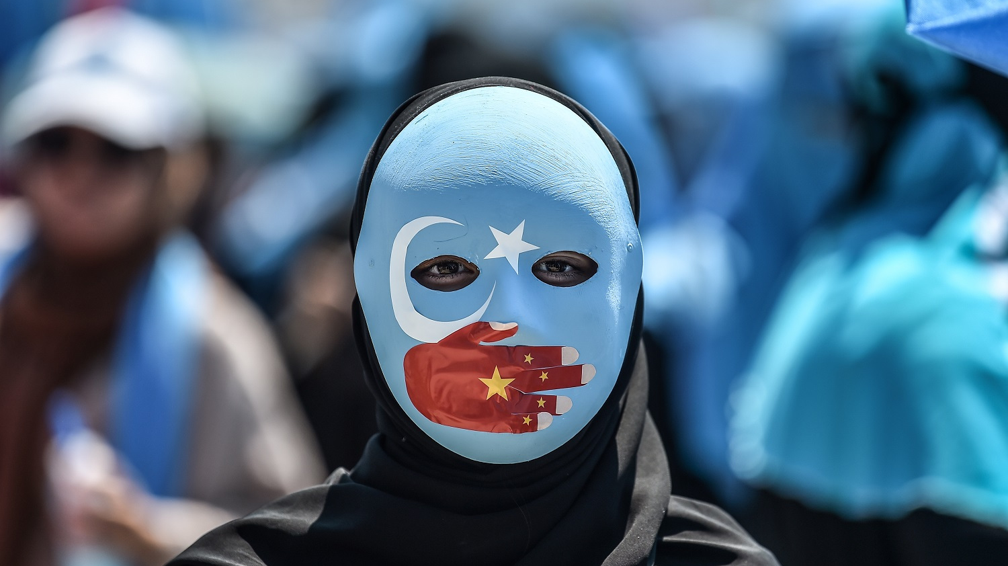
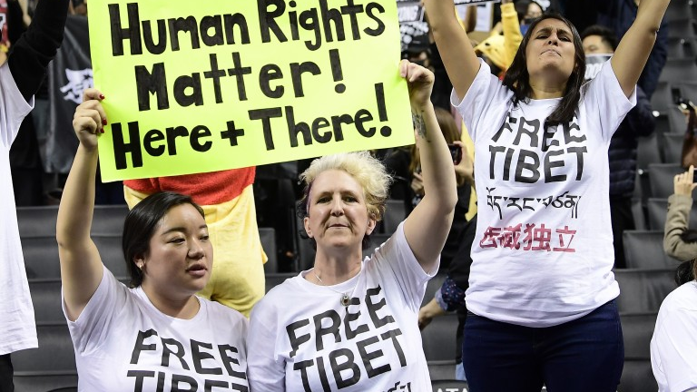
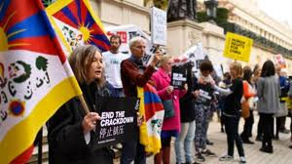
Human Rights Violations
Selden Tenzing
English 110

Slide 2
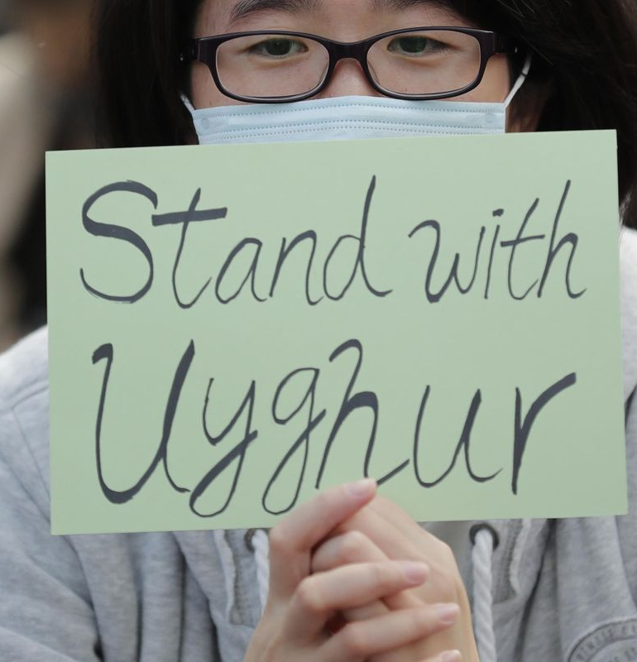
Background Information
The government strengthened its restrictions to the rights to freedom of expression, association and peaceful assembly. The authorities rigorously censored all media, from print media to online games.
Beijing continued to tighten its grip on Christians and Muslims as China pushed ahead with the “sinicization of religion”, which Premier Li Keqiang reiterated at the National People's Congress in March. Many Buddhist and Taoist temples and statues, along with mosques and churches, were damaged or destroyed on the direction of the government.
The authorities sustained a crackdown on dissent and independent voices. Prominent human rights lawyer Gao Zhisheng, who launched a memoir detailing his experience of enforced disappearance, torture and other ill-treatment, and illegal house arrest, was again forcibly disappeared in August 2017.
China has one of the largest populations of religious prisoners, and some groups, including Uighur Muslims, face high levels of persecution

Slide 3
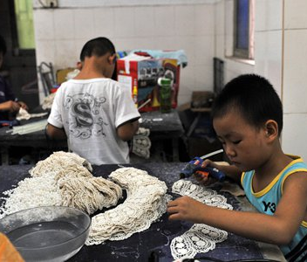
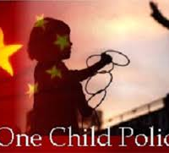
Examples of human rights violations
KYE factory in south China, hires hundreds to thousands working students whose age ranges from 16 to 17 years old.
No freedom of press/religion
Religious persecution
China’s “One child policy”

Slide 4
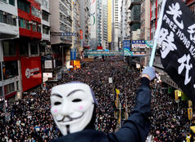
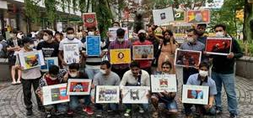
Essay
China must be held accountable for their actions because they have been exploiting their power which is supposed to be used to help their citizens.
Human rights are basic rights that we have been given at birth
Many people have decided to show support through social protest, calling out government officials and by bringing awareness through social media platforms.

Slide 5
Essay
China uses the fact that they are a mass producer as a tactic to keep others quite
Chinese Communism Party abuses its power to exploit human rights of Chinese citizens through many ways such as death penalties, no freedom of speech, association, and religion, unlawful detention, physical torturing, harsh treatments on national minority and etc.
Majority of the local and international corporations enter China due to its low manufacturing cost. The low cost of labor has been a great consideration for business owners who need intensive manufacturing procedures to accomplish. Investments from foreign companies have been around in China since the mid 80’s. Investing in China has been a form of mutualism for both the nation and the foreign depositors. Investments contribute to the development of the industry and infrastructures in the country

Slide 6
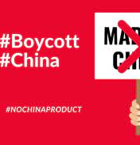
Essay
Some legislators include the prohibition of high Chinese government officials to come to the United States.
Trade restrictions on certain goods, and less money to be given as foreign aid to China are a probable solution.
Boycotting the products

Slide 7
Work cited
China: Backlash Against Increasing Repression.” Human Rights Watch, 28 Oct. 2020, www.hrw.org/news/2020/01/14/china-backlash-against-increasing-repression.
Crowley, Michael. “Trump Says He Avoided Punishing China Over Uighur Camps to Protect Trade Talks.” The New York Times, The New York Times, 22 June 2020.Digital. www.nytimes.com/2020/06/21/us/politics/trump-uighurs-china-trade.html.
Haenle, Paul, and Lucas Tcheyan. “How the World Is Responding to a Changing China.” Carnegie Endowment for International Peace, 10 June 2020.Digital. carnegieendowment.org/2020/06/10/how-world-is-responding-to-changing-china-pub-82039.
Loya, Luis, and Doug McLeod. “Social Protest.” Obo, Oxford Bibliographies, 2019. Digital. www.oxfordbibliographies.com/view/document/obo-9780199756841/obo-9780199756841-0005.xml.
Tĩnh Lê, Trung. “Sign the Petition.” Change.org, www.change.org/p/general-secretary-of-the-united-nations-and-world-leaders-remove-china-from-un-security-council-permanent-members.

Slide 8
Work cited
China's Disregard for Human Rights - United States Department of State.” U.S. Department of State, U.S. Department of State, 18 Nov. 2020, www.state.gov/chinas-disregard-for-human-rights/.
Buckley, Chris and Austin Ramzy. “Facing Criticism Over Muslim Camps, China Says: What's the Problem?” The New York Times, The New York Times, 9 Dec. 2019, www.nytimes.com/2019/12/09/world/asia/china-camps-muslims.html.
Crowley, Michael. “Trump Says He Avoided Punishing China Over Uighur Camps to Protect Trade Talks.” The New York Times, The New York Times, 22 June 2020.Digital. www.nytimes.com/2020/06/21/us/politics/trump-uighurs-china-trade.html.
Sudworth, John. “China Uighurs: A Model's Video Gives a Rare Glimpse inside Internment.” BBC News, BBC, 4 Aug. 2020, www.bbc.com/news/world-asia-china-53650246.

