Slide 1
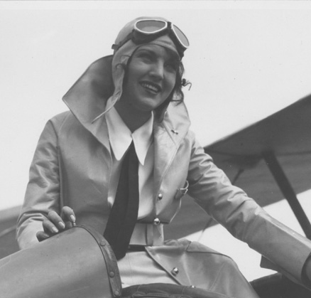
AVIATRIX THE FUTURE OF THE SKIES
By Ewelina Randall

Slide 2
OUTLINE
Women in Aviation- Intro
What people say?
Why women are great pilots
How can we increase number of aviatrixes?
Conclusion
Works cited page

Slide 3
women in aviation intro
Women are 5% of commercial pilots
"Aviatrix", term that describes female pilot was born in 1907
Nowadays there are fewer women pilots than men due to the industry characteristics being built of male needs
Women are highly discouraged what causes their low success rate

Slide 4
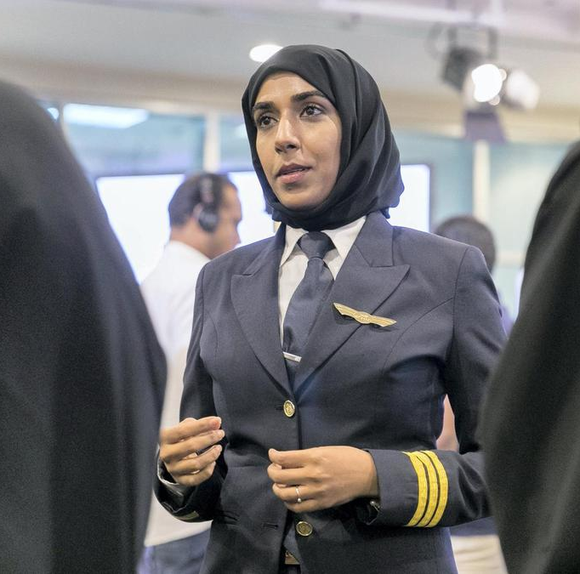
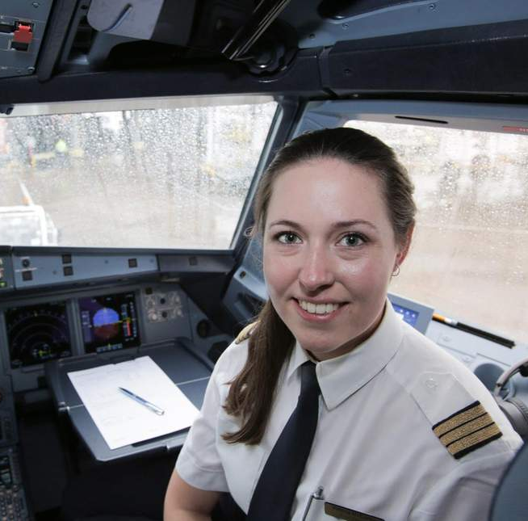
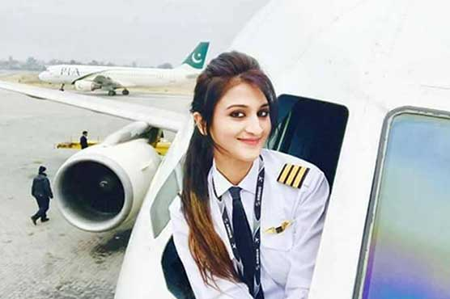
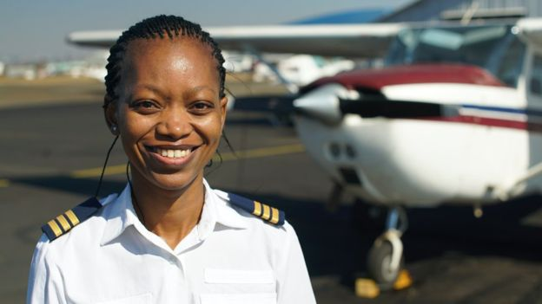
Aviatrixes today

Slide 5
why women shouldn't fly?
Women are not able to fly; their capabilities are much lower than men's
Equipment is not built for women needs
Aviation community is based on male needs
Pilots aren't used to train with women
Women don't feel comfortable in the sexist environment
Women are highly discouraged what causes their low success rate

Slide 6
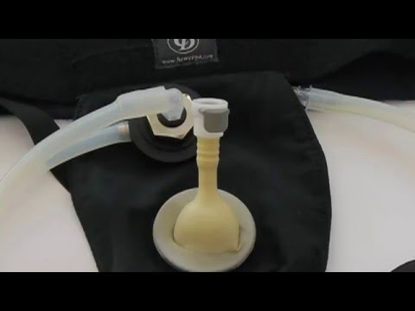
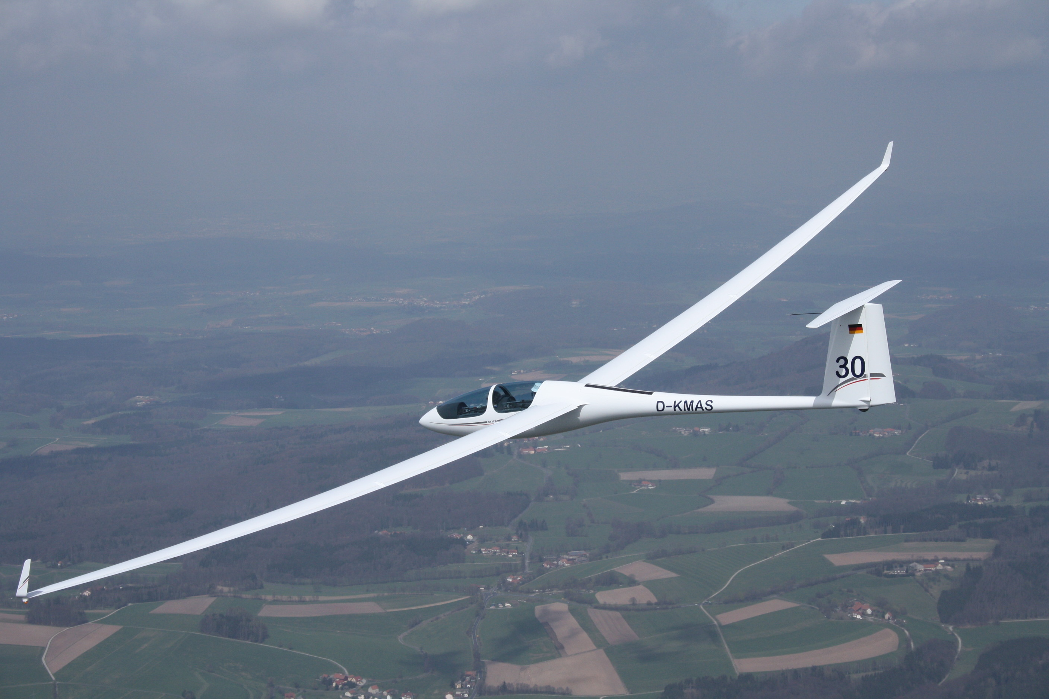
EQUIPMENT NOT BUILD FOR FEMALE NEEDS

Slide 7
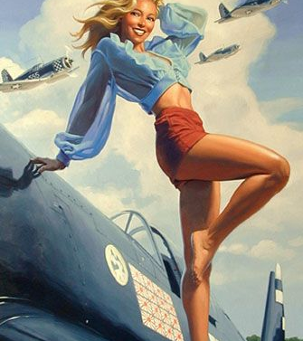
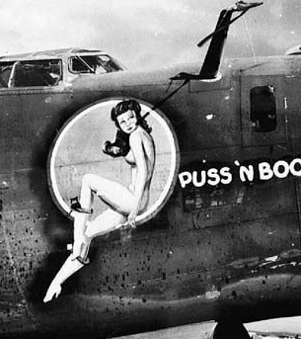
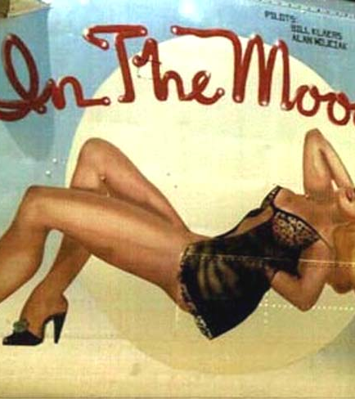
WORLD WAR II PINUP

Slide 8
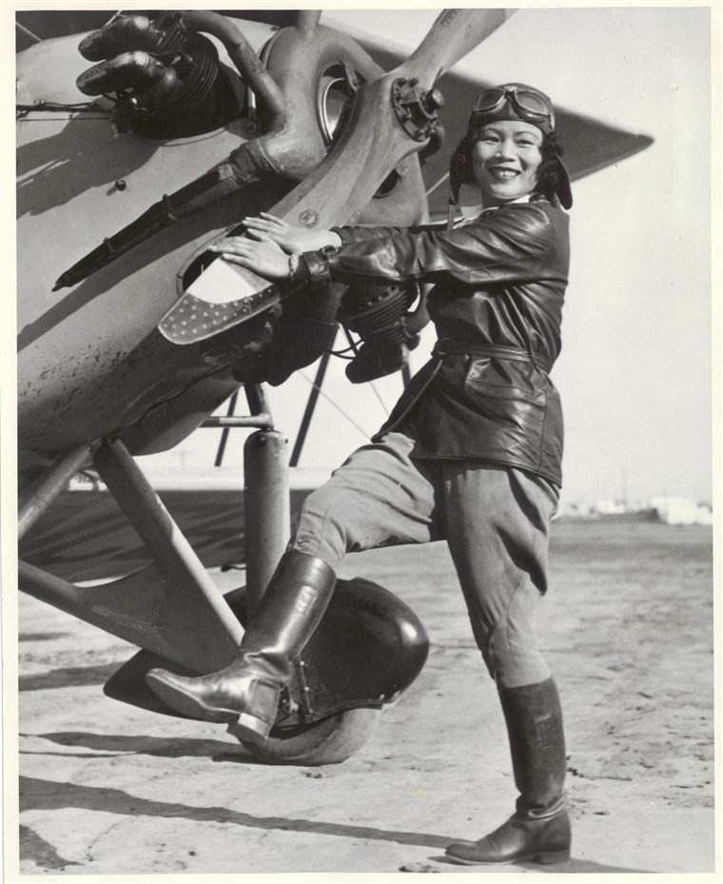
what makes women great pilots?
Proven lower rate of fatal accidents
Less risk taken during the flight
Great at multitasking
34% of NASA astronauts are women
Their exam scores are as high as men's

Slide 9
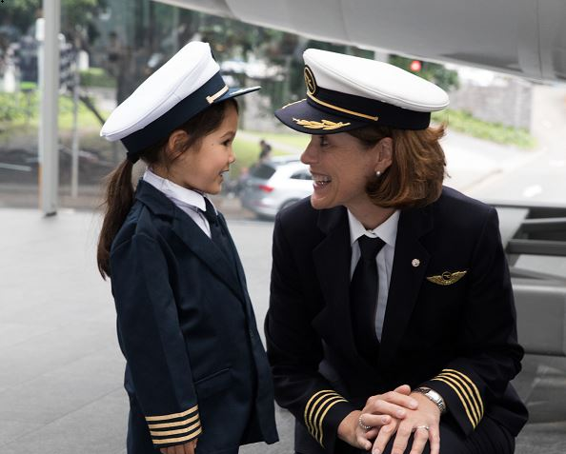
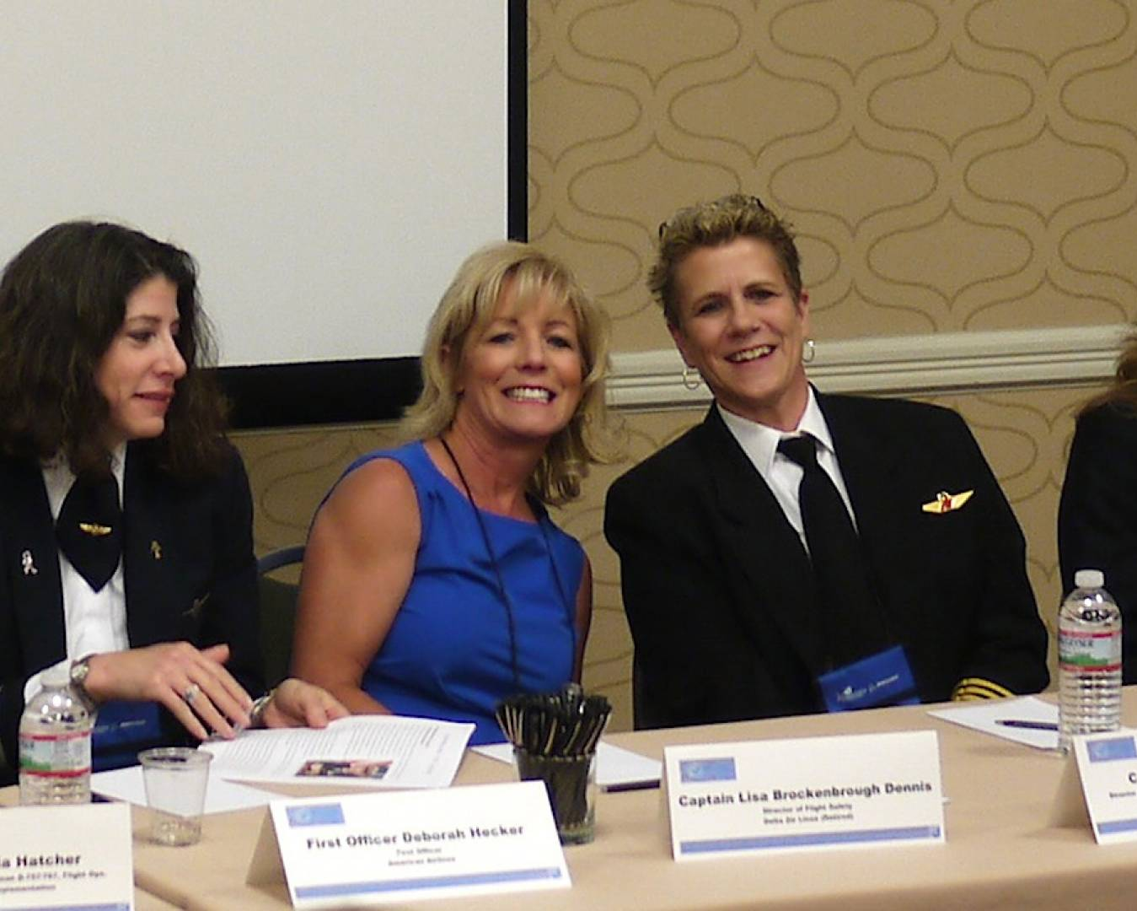
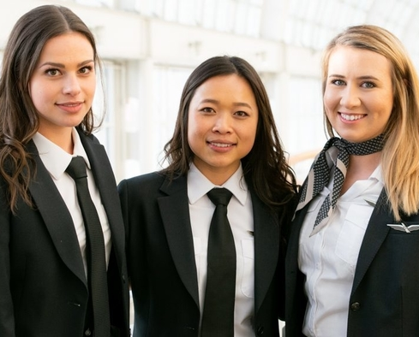
Aviatrixes are the future

Slide 10
how to change it?
Women in Aviation International, The Ninety-Nines
Encourage young girls to be part of STEM and fly!
Be nice and friendly
Follow your heart and pursue your passion

Slide 11
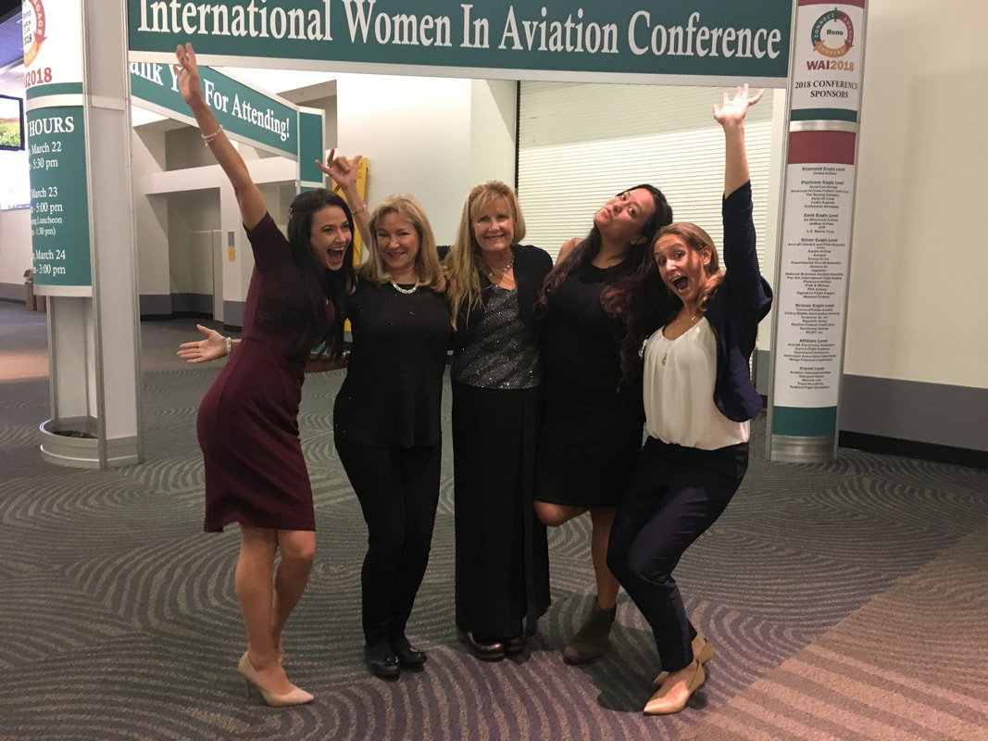
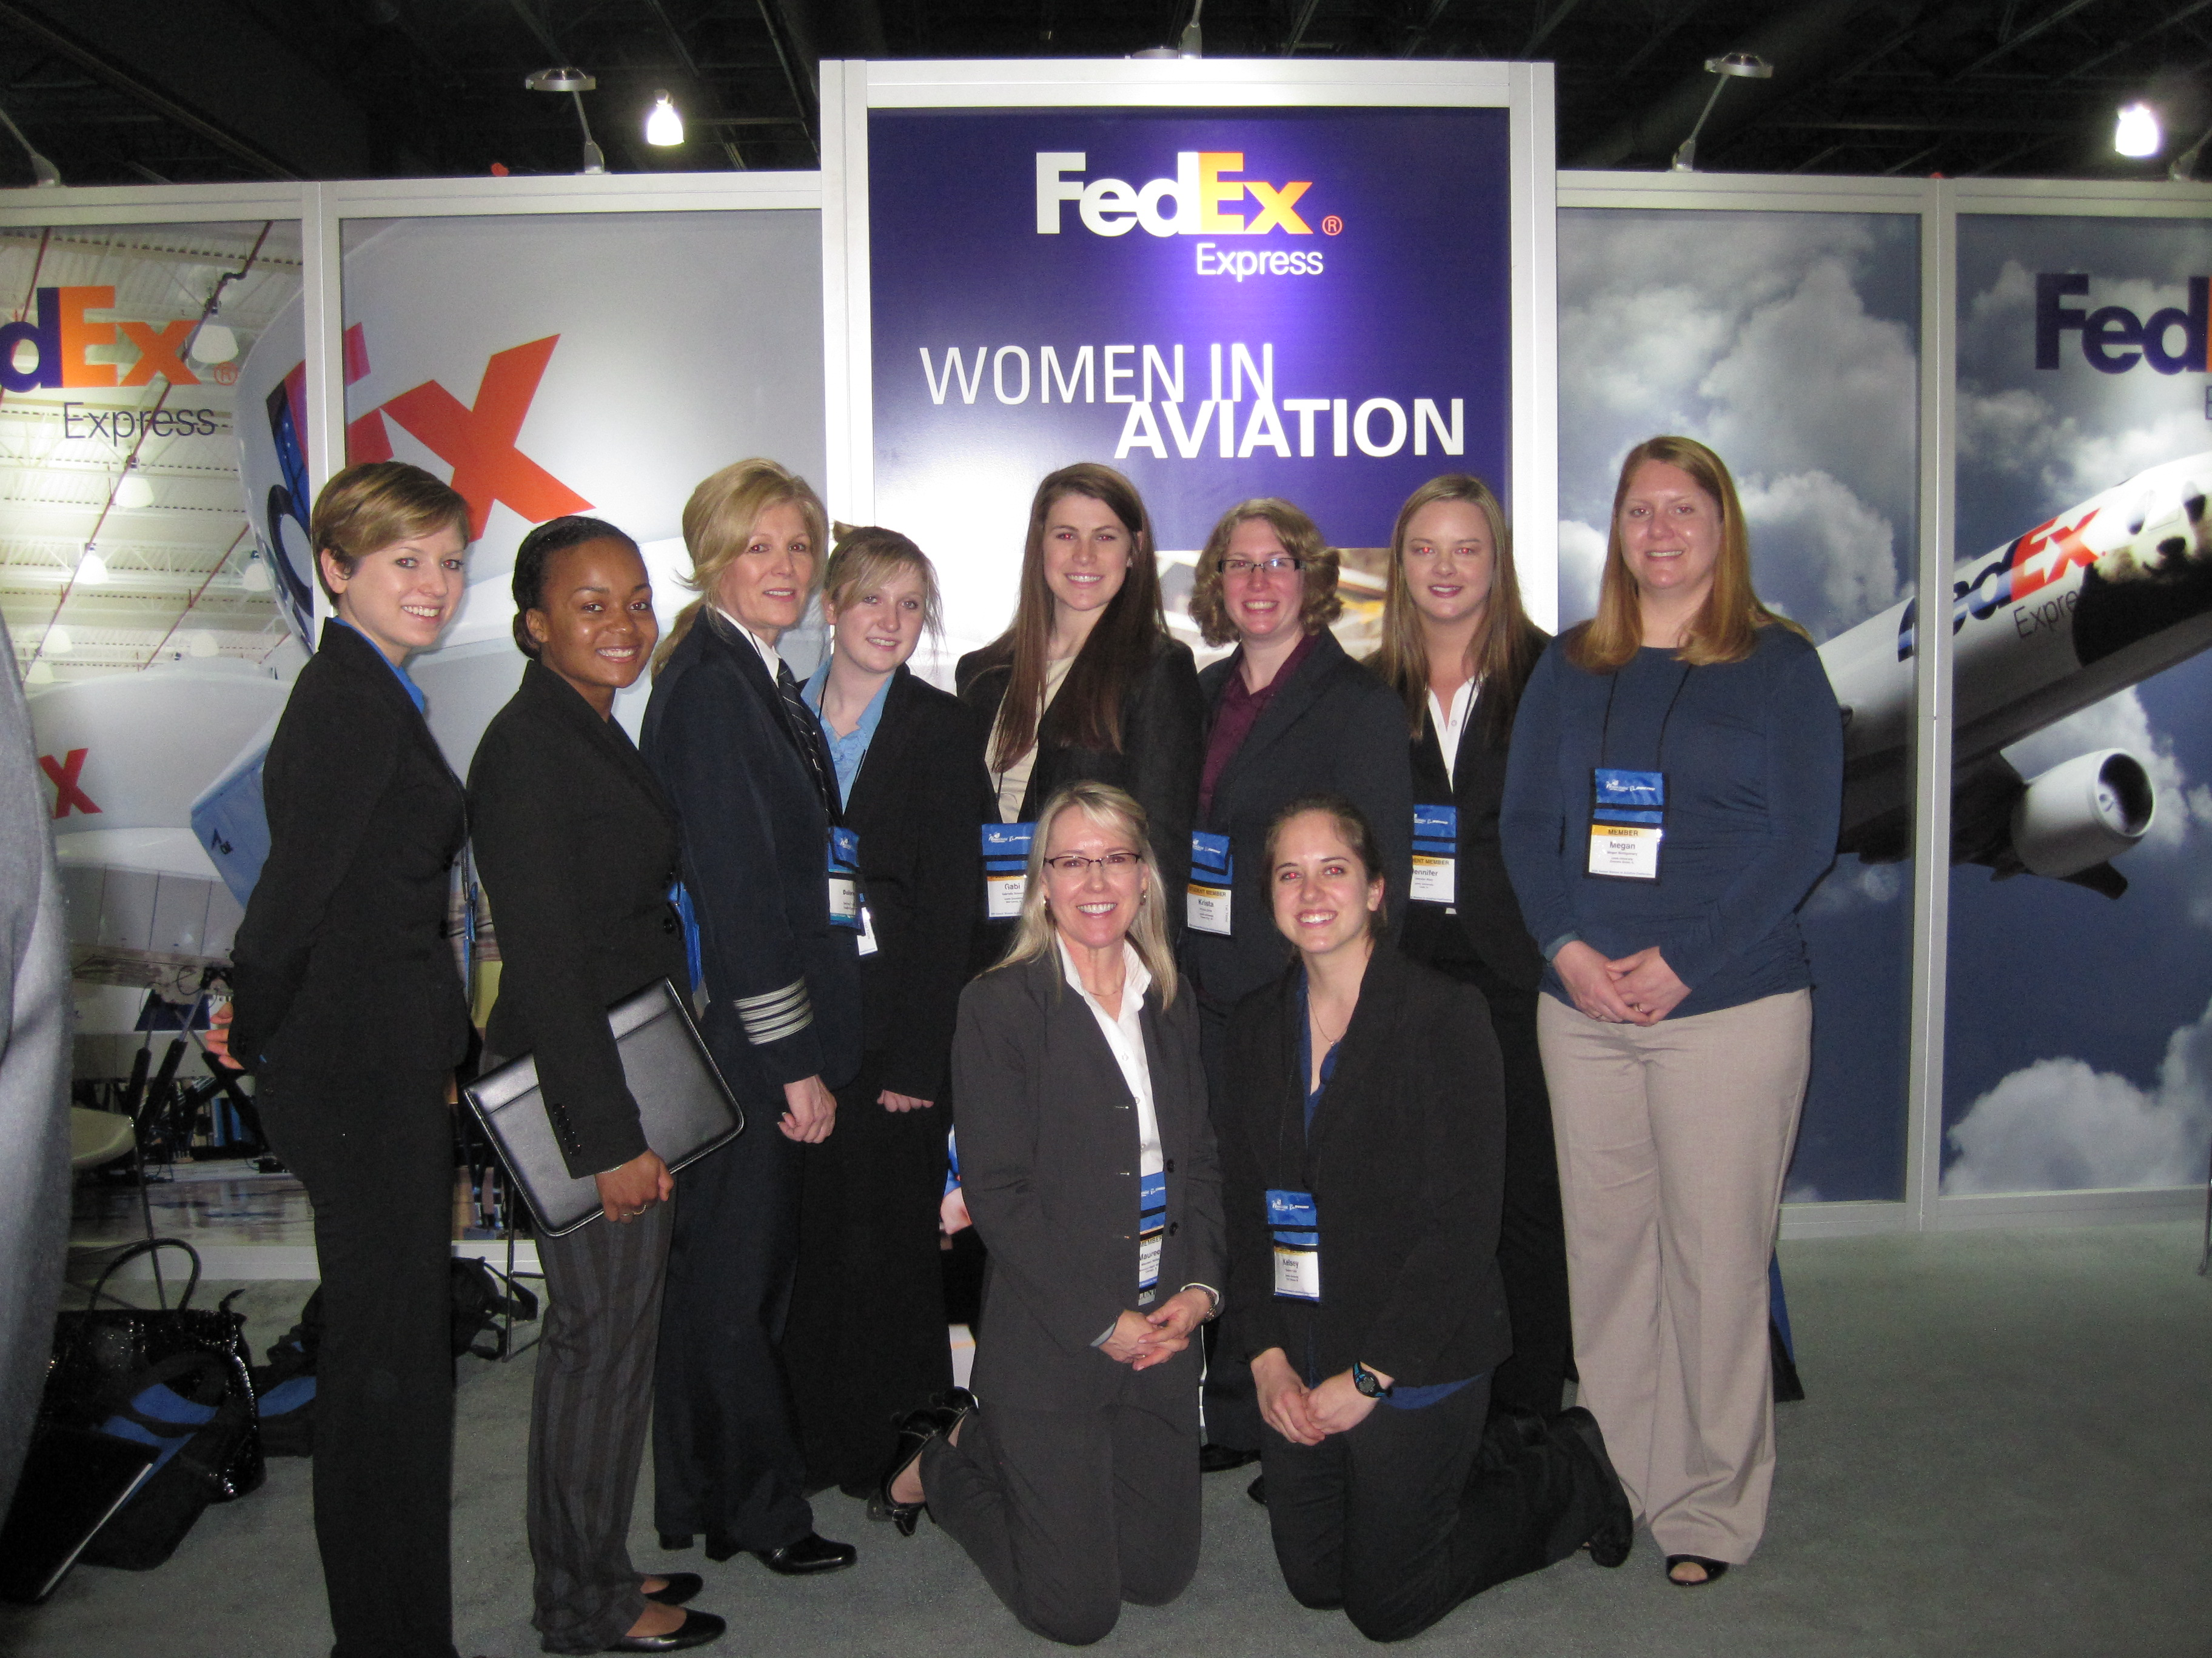
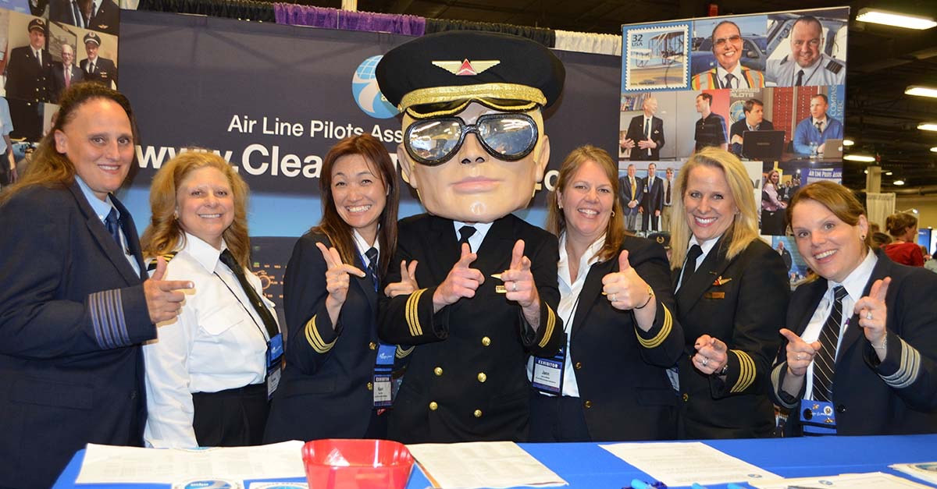

Slide 12
conclusion
Women are discouraged by aviation industry being built on the male needs
Aviatrixes are as good pilots as men
We need more women in aviation
Let's leave stereotypes behind and FLY!

Slide 13
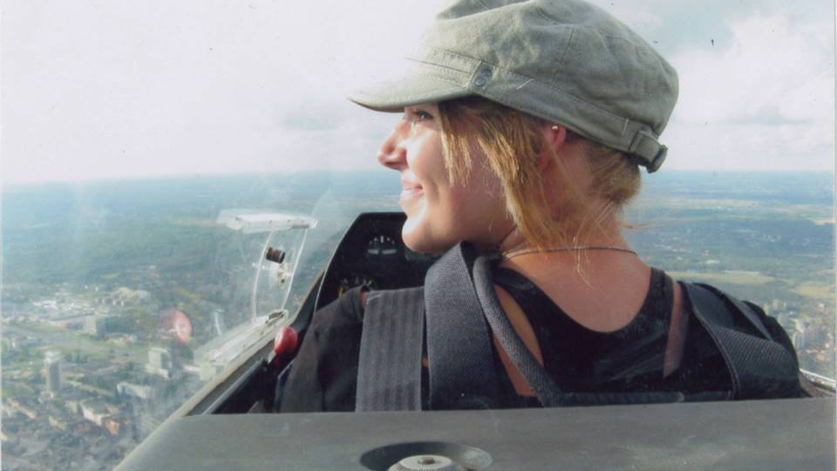
Thank you

Slide 14
WORKS CITED PAGE
Bazargan, Massoud, and Vitaly Guzhva “Impact of Gender, Age and Experience of Pilots on General Aviation Accidents.” Accident Analysis and Prevention. Vol. 43, no. 3. 2011: 962–970. Print.
Eliot Lise, “Neurosexism: the myth that men and women have different brains”, Nature.com, February 27 2019, nature.com/articles/d41586-019-00677-x, Accessed April 14 2019
Messy Nessy. “Flying Girls: A Compedium of WW2 Airplane Pin-Ups”. Messy Nessy, March messynessychic.com/2015/08/28/flying-girls-a-compendium-of-ww2-airplane-pin-ups/. Accessed 14 April 2019
Ramm Darryl, “ Glider Pee Tubes”, Darryl’s Blog, March 28 2007, darrylramm.wordpress.com/gliderPee-tubes/. Accessed April 13 2019
Tinoco, Janet Kay and Genderie Rivera. “Absent Aviators: Gender Issues in Aviation.” Equality, Diversity and Inclusion: An International Journal. Vol. 36, no. 1, 2017: 105–107. Print.
WITW, “Nasa head says a women will walk on the moon an potentially Mars”. Women in the World, March 14 2019, womenintheworld.com/2019/03/14/nasa-head-says-a-woman-will-walk-on-the-moon-and-potentially-mars/. Accessed April 14 2019

