Slide 1
The Powerpoint on Powerpoints
Building a presentation

Slide 2
Students will be able to…
Critically analyze and edit their own papers and extract relevant content for use in a powerpoint presentation
Construct a well structured powerpoint
Consider the rhetorical situation for a powerpoint.
How is it different from the rhetorical situation for a paper essay?

Slide 3
Rhetorical situation
How, if at all, does the rhetorical situation change?

Slide 4
Four basic types of presentations
Impromptu
Extemporaneous*
Scripted*
Memorized

Slide 5
What are the advantage of oral presentation?
It encourages and enables dialogue between speaker and audience!
Removes the wall/separation between the two sides.

Slide 6
What are the challenges of oral presentation?
Listeners can’t reread something they didn’t understand.
Maintaining audience attention.

Slide 7
Powerpoints need…
Clear structure-
Engaging beginnings- might forecast the central parts of your lecture
Text- focus on main points
Ending- something memorable, perhaps places topic in a larger context, gives audience something to consider.
Transitions to segue between topics
Appropriate tone
Relevant graphics, audio, video, etc.

Slide 8
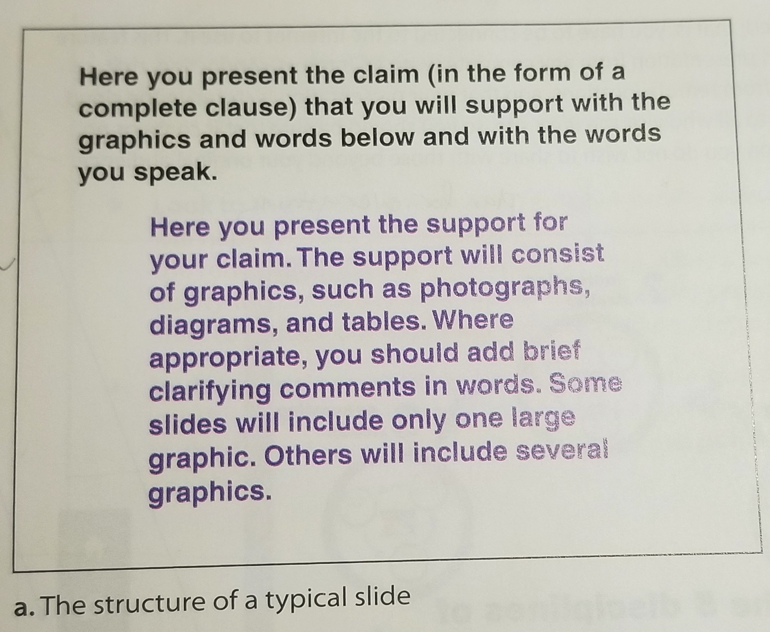
Slide Construction
Presents a Clear and Well supported slide
It is easy to see
It is easy to read
It Is simple
It is correct
Markel 584

Slide 9
Things to consider…
Draft work
scripts
Budgeting your time
Rehearse!
Presentation delivery
Speak clearly, slowly, and loud! Project your voice.
Try not to be stiff
Pause for emphasis and allowing the audience to catch up and process
Look at the entire audience
The presentation of the presentation
Font color and size
Try to avoid paragraphs, use lists
Clear photos
Animation

