Slide 1
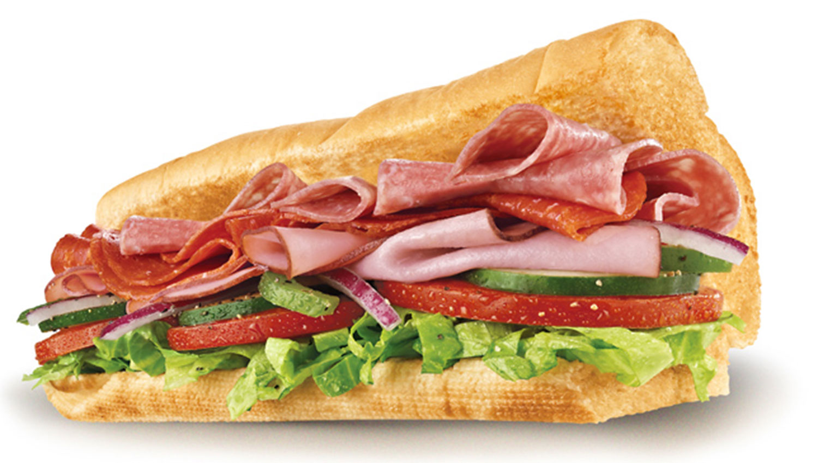
Essays are like… sandwiches
Introductions, conclusions, thesis statements, body paragraphs and citation work

Slide 2
Students will be able to…
Discuss and understand the requirements for the next assignment: expository/discussion essay
Identify and discuss the essential parts of an essay: conclusion, introduction, thesis statement, body paragraphs, and citations
Build each piece separately, edit each piece, and eventually connect them in order to produce a complete essay

Slide 3
Essays are like… sandwiches
Top bun- introductory paragraph
Mayonnaise, ketchup, lettuce, tomato, condiments- Clear and logical transitions between introductions, body and conclusion
Meat/insides- body paragraphs
Bottom bun- conclusion
Salt and pepper- citation work

Slide 4
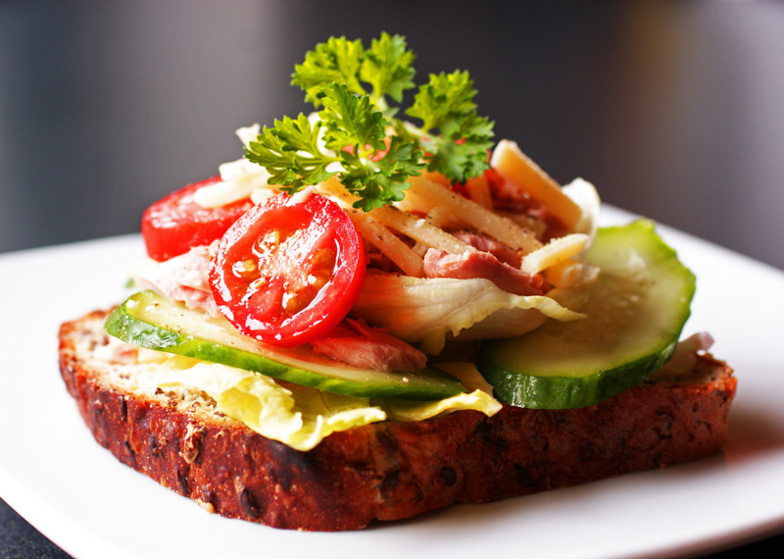
Sandwiches…
Top bun- introductory paragraph
includes leading sentences (road map) to deliver reader(s) to a clear, concise, and well defined thesis statement.
Mayonnaise, ketchup, lettuce, tomato, condiments- Clear and logical transitions between introductions, body and conclusion

Slide 5
Sandwiches…
Meat/insides- body paragraphs
includes evidential support. Each paragraph must have some connection to the description/explanation of one general idea. Each paragraph must have some connection to the thesis statement. The content of the body paragraphs could contain factual, logical, statistical, anecdotal evidence, etc. However you decide to support your argument, the body paragraphs MUST contain the EVIDENCE to back up the thesis.
Bottom bun- conclusion
Not just a re-stating of the thesis, but a re-addressing of the thesis In the light of the evidence just presented. Do NOT introduce any new information in the conclusion, approach the conclusion regarding the information that was just presented.

Slide 6
Sandwiches…
Salt and pepper- citation work
Sprinkled among the meat and condiments to give it flavor. Perhaps you needed outside sources to help make your argument or disprove someone else’s. Those ideas that weren’t yours, they need citing. And a works cited page at the end listing the sources that you used.

